Slide 1

Edge-AI with Google Edge TPU: Sensor Fusion (Camera + COx Sensor)
Team:
Rakshitha Kukke Prakash
Sree Samanvitha Manoor Vadhoolas
Sai Swaroop Maram
Sunil Dabbiru
Mahima Desai

Slide 2
What is Google Coral Mini
Compact Design
Edge TPU
Software Support
Versatile Connectivity

Slide 3
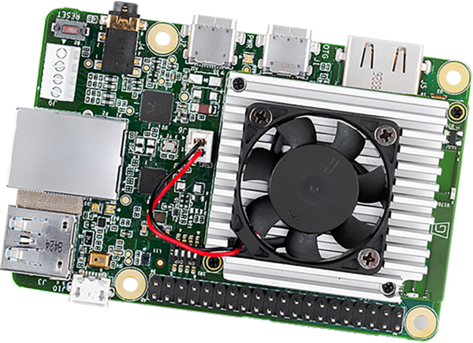
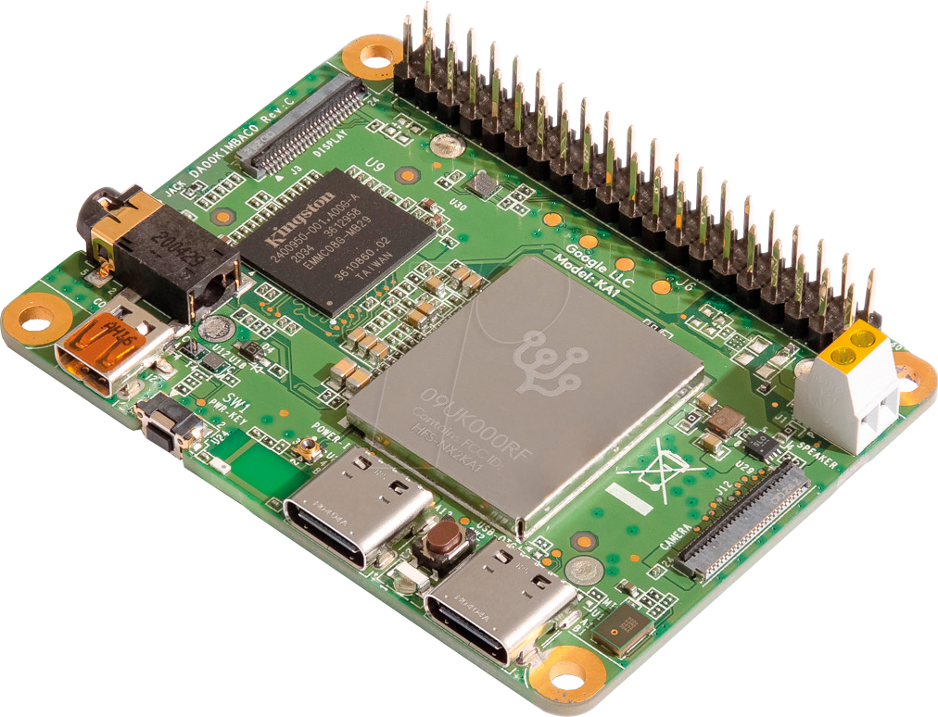
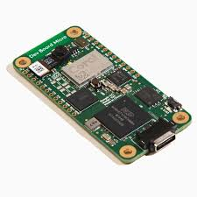
Images Source: Google

Slide 4
Key features of Coral Mini
The Google Coral Mini offers a range of features that make it a versatile and powerful edge computing device.
1
Low Power Consumption
2
On-device Machine Learning
3
Customizable Functionality
4
Open Source Ecosystem

Slide 5
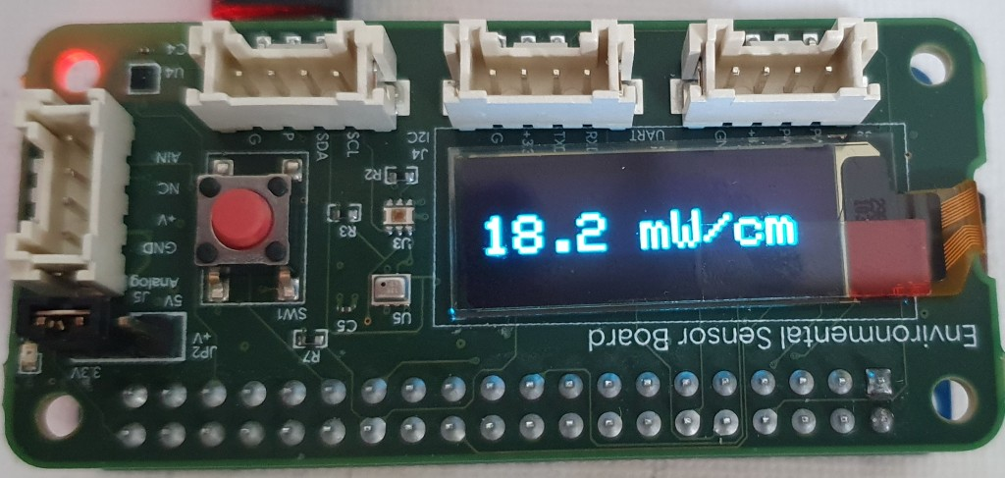
What is Environmental Sensor Board?
Multiple Sensors
Real-Time Monitoring
Data Acquisition
Images Source: Google

Slide 6
Capabilities of Environmental Sensor Board
Feature
Description
Temperature Sensing
Measures ambient temperature for precise monitoring.
Humidity Sensing
Determines relative humidity levels in the environment.
Pressure Sensing
Measures atmospheric pressure for altitude and weather analysis.
Light Sensing
Detects ambient light intensity for illumination control and analysis.

Slide 7




Applications and Use cases
Smart Agriculture
Environmental Monitoring
Building Automation
Industrial Automation

Slide 8
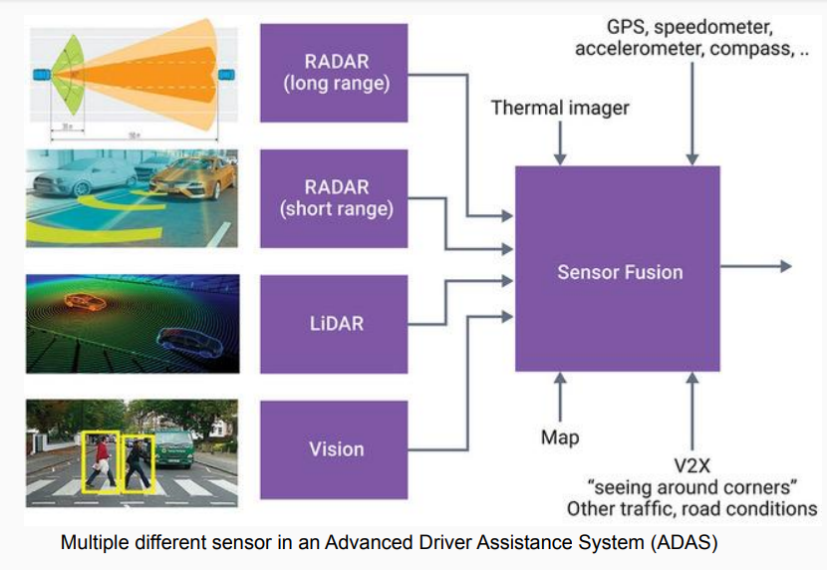
What is Sensor Fusion?
Sensor Fusion
The process of combining data from multiple sensors to improve the accuracy and reliability of information. There are two main types of sensor fusion techniques:
● Decision Level Fusion
● Feature Level Fusion
8
Images Source: Google

Slide 9
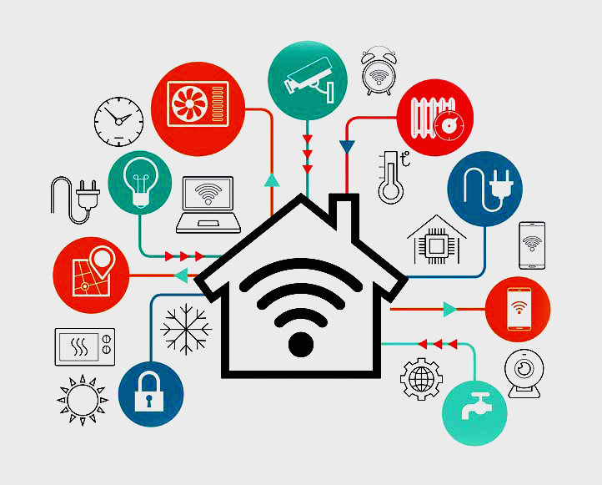
Decision Level Fusion
It is a process in which multiple independent decisions or outputs from different sources or subsystems are combined or aggregated to make a final decision or inference. Example: Smart-Home security. Decision-level fusion works as follows:
● Individual Sensor Decisions.
● Decision Combination.
● Voting or Consensus.
● Action.
Images Source: Google

Slide 10
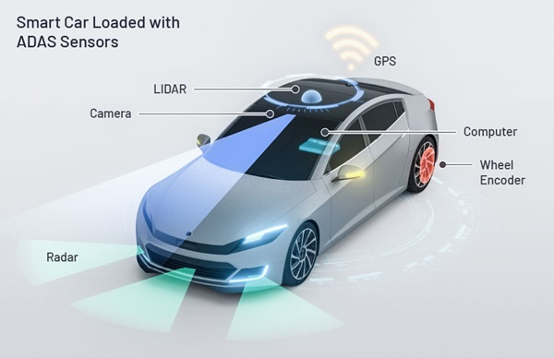
Feature Level Fusion
It is a technique that involves combining or fusing the extracted features from multiple sensors to create a new set of features that capture the complementary or correlated information from each sensor. Here is an example of feature-level fusion in the context of autonomous vehicles perception:
Feature Level Sensor Fusion in a car with Camera sensor, Lidar sensor and Radar sensor Feature level fusion combines these extracted features from different sensors:
Object association
Redundancy and Confidence
Environmental modelling
Decision-Making
Images Source: Google

Slide 11
Why Sensor Fusion?
Enhanced Accuracy and Reliability. Robustness and Redundancy. Improved Situational Awareness. Enhanced Performance. Versatility and Flexibility.

Slide 12
Framework - TensorFlow
TensorFlow
Open-source AI framework by Google
Supports machine learning and high-performance numerical computation
Primarily written in Python, with core components in C++
TensorFlow Lite
Deep learning framework designed for on-device machine learning.
Key features - small binary size, fast execution, cross-platform compatibility, and support for hardware acceleration.
Applications include image classification, object detection, natural language processing, and gesture recognition.

Slide 13
Advantages and Limitations of TensorFlow Lite
Advantages: - Reduced latency - Lower power consumption - Enhanced privacy
Limitations: - Limited operation support - Hardware constraints
TensorFlow Lite on Coral Dev Board Mini
TensorFlow Lite is optimized for mobile and embedded devices, ensuring that machine learning models can run efficiently on devices with limited computational resources. Its small binary size, fast execution, cross-platform compatibility, and support for hardware acceleration make it an ideal choice for deploying models on the Coral Dev Board Mini.
This combination ensures that our object detection model can operate effectively in real-time on edge devices, making it suitable for applications like fire detection, where immediate response is crucial.

Slide 14
Image Classification
Image Classification is the process of using a specific algorithm through the input image to provide a model, which outputs the class or the probability of the class to which the image belongs.
Deep learning can be classified as the subfield of machine learning.
Example: Identifying images as cat, dog, or bird
Applications
Medical Imaging: Diagnosing diseases from X-rays or MRIs
Social Media: Organizing and tagging photos
Automotive: Advanced Driver Assistance Systems (ADAS) for Traffic Sign Recognition, Lane departure warning, Driver Drowsiness Detection

Slide 15
Object Detection
Identifies and locates objects within an image
Provides class labels and bounding boxes for multiple objects
Applications
Autonomous Driving: Detecting pedestrians, vehicles
Security Systems: Monitoring for intruders
Retail: Inventory management
Benefits
Provides precise object locations
Detects multiple objects in complex scenes
Essential for real-time applications

Slide 16
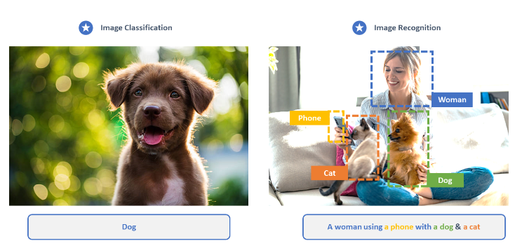
Image Classification vs Object Detection
(Source: https://research.aimultiple.com/image-recognition-vs-classification/)

Slide 17
COCO Dataset
COCO (Common Objects in Context)
Large-scale dataset for object detection, segmentation, and image captioning
Over 330,000 images and 80 object categories
Advantages:
Comprehensive object annotations
Handles complex real-world scenarios
Robust for varying conditions (lighting, occlusions, backgrounds)
Use of COCO in the current Project
Essential for accurate human detection
Operates effectively in diverse environments
Compatible with TensorFlow Lite for edge devices

Slide 18
Use case : Fire Detection
If human is detected and carbon monoxide is present
Object Detection
Check sensor value
Indicate using LED and printing a message
Decision Level Sensor Fusion

Slide 19
MQ - 7 CO Sensor
The MQ-7 sensor is a widely used gas sensor for detecting carbon monoxide (CO). It operates on the principle of a tin dioxide (SnO2) sensing layer, whose conductivity varies in the presence of CO gas.
Concentration Range: 10 to 10,000 ppm (parts per million)
Power Consumption: High heater current (~5V)
Sensitivity: Good sensitivity to CO
Response Time: Fast response and recovery time
Pin Configuration - Supply of 5V, Ground, Digital Out and Analog out
We selected this sensor for our use case as we have a small threshold to be detected by the sensor and also as we are having only the detection of CO gas.

Slide 20
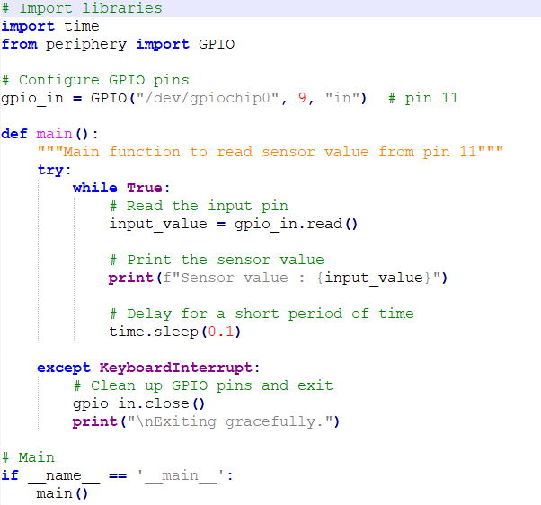
Calibration of the Carbon Monoxide Sensor
We need to calibrate the carbon monoxide sensor at our desired threshold value.
We run this simple code on Google Coral Mini which keeps printing the read sensor value.
Now we vary the potentiometer value and set the threshold.

Slide 21
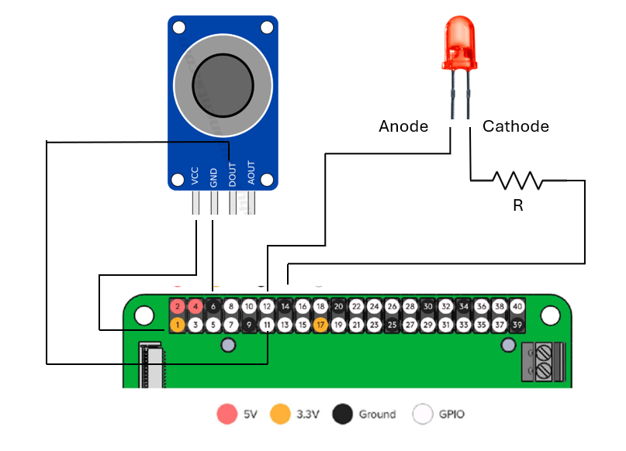
Connection for the CO sensor and LED
MQ-7
CO Sensor

Slide 22
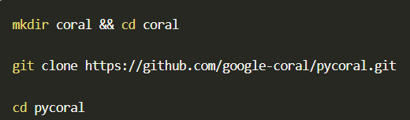
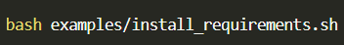
Installation of object detection model
The model used for the project is a pre-trained model. For installing this model to Google Coral Mini, we need to clone pycoral library into the board by typing the following commands
Then we need to add the model labels as well by using the following command

Slide 23
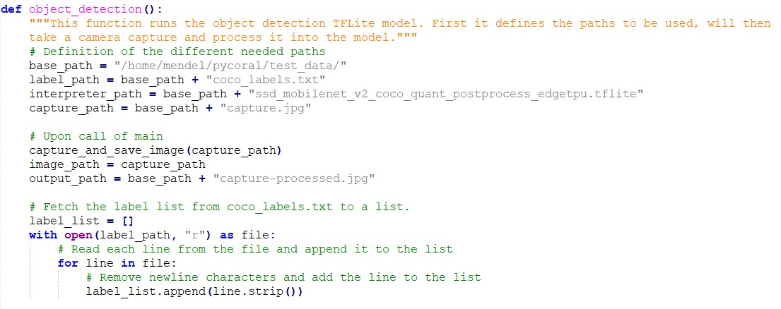
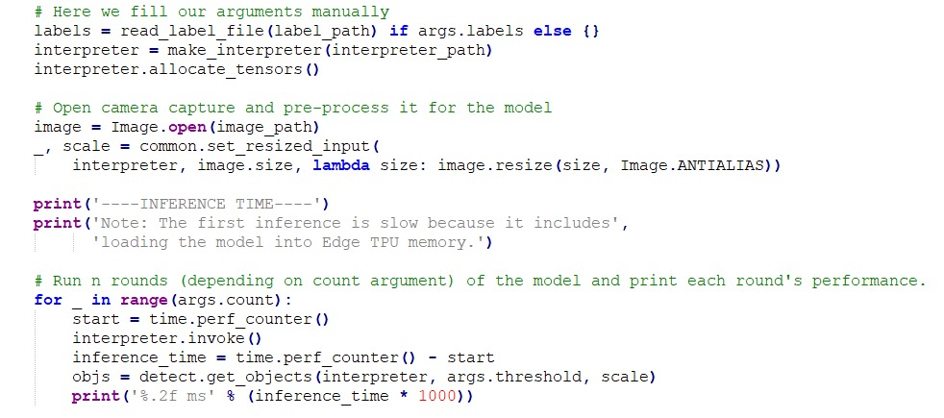
Object detection code

Slide 24
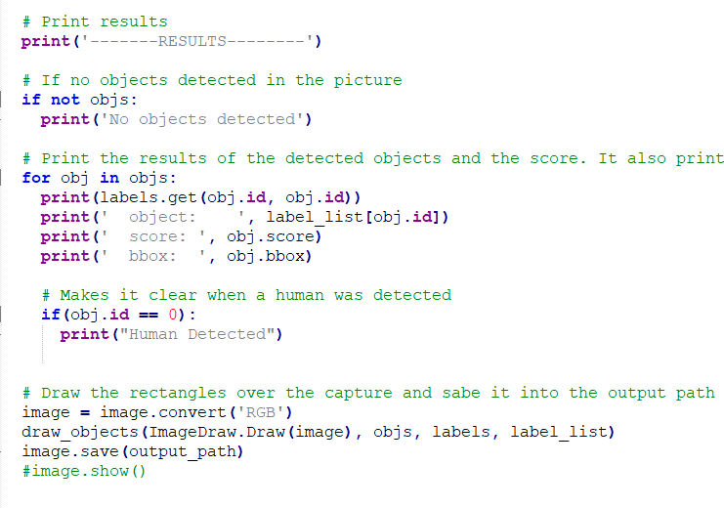
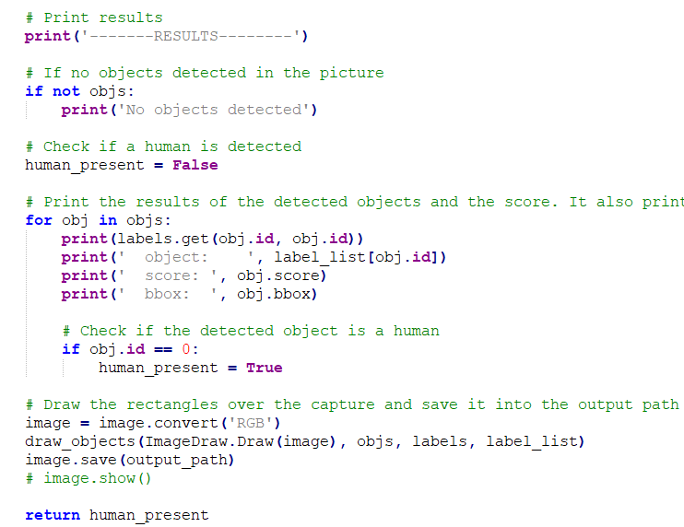
Modification of the sensor fusion code
We modify the object detection function to return a Boolean value for human detection.

Slide 25
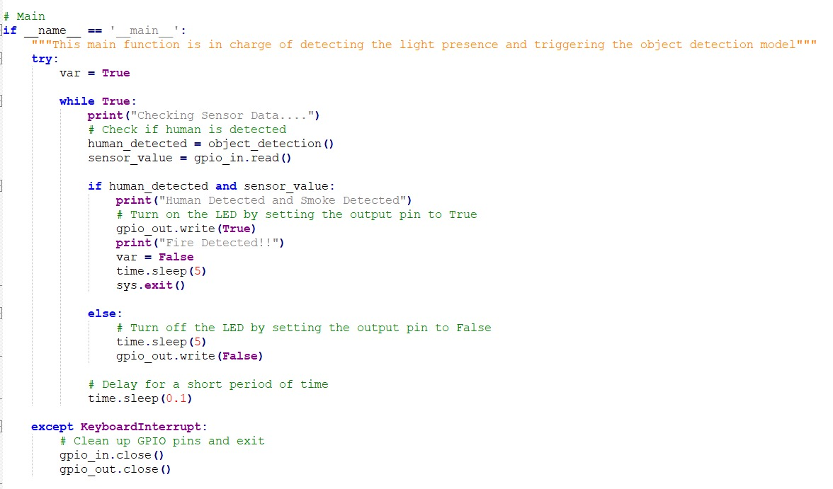
Main function call

Slide 26
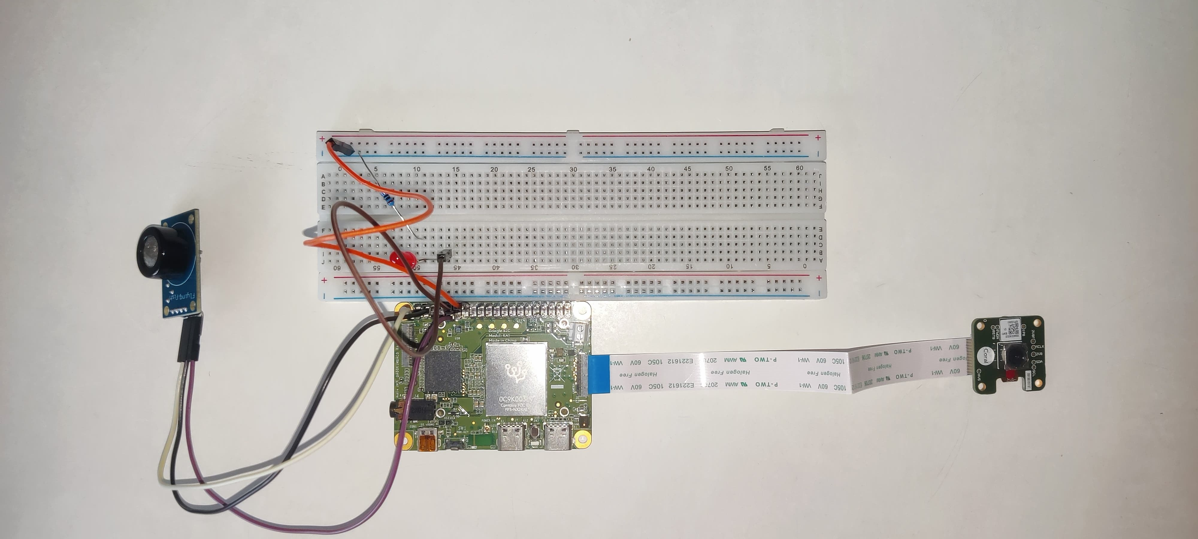
Test Setup
COx sensor
LED
Coral Camera
Google Coral Mini

Slide 27
How to run
Enter the Coral Mini terminal with „mdt shell“ command
Upload the desired library for the Tensor Flow Lite model
Place the system with connected camera and sensor.
Execute the project script with „python3 scf_demo2.py“. The environment is scanned and objects are detected and printed on terminal
Ensure that a human in front of the camera
Provide sensor input to the COx sensor such that the threshold is met. (Threshold can be adjusted as per requirement using potentiometer)

Slide 28
How to run – additional steps
To retreive images/ files saved in the Google Coral Mini board or to update/ send a file from Host OS (Windows): First exit from the shell of the board using „exit“ command
Push code/ file to Google Coral mini
Get image/ file from Google Coral mini

Slide 29
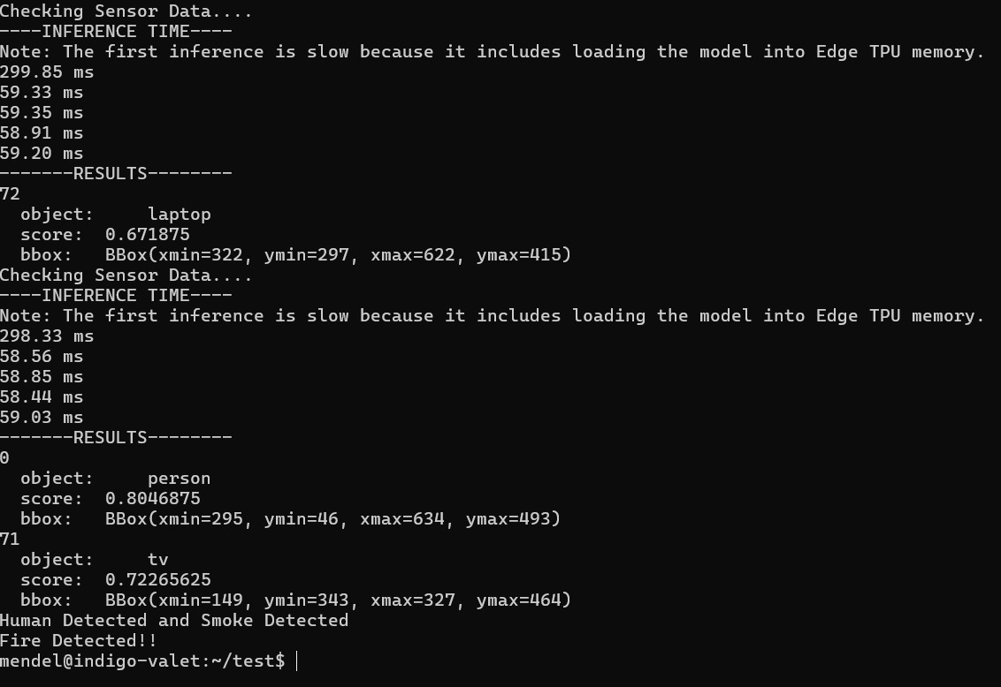
Results

Slide 30
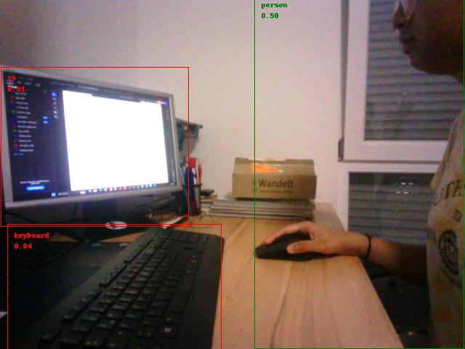
Results

Slide 31
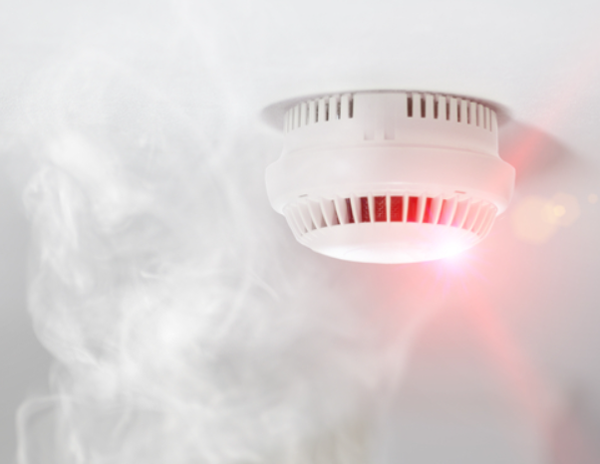
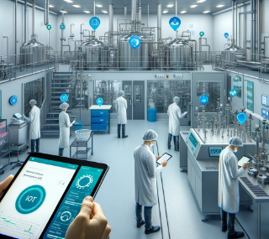
Applications
Fire safety and prevention: Home safety system, Industries, Office buildings, Schools, Hospitals etc.
Agricultural and Forest Monitoring: Forest Fire Detection, Farm Security
Environmental Monitoring: Industrial Plants Mining Operations
Images Source: Google

Slide 32
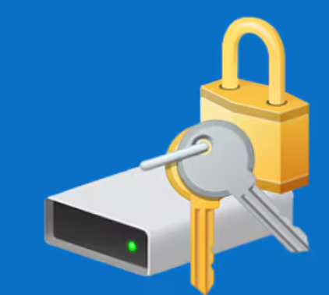
Lessons Learnt
Choice of Environment: Windows vs Linux vs Virtual Machine
Windows: Ease of usage, more availability of tools
Virtual Machine: could be used for mitigating issues (Setup source: Ubuntu 22.04 In VirtualBox - The Complete Guide (youtube.com))
Linux: seamless experience, stable, most preferable, only option for force fastboot
Dual boot for Windows 11 Home was not possible due to bitlocker encryption.
Images Source: Google

Slide 33
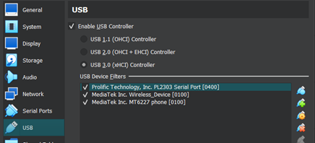
Lessons Learnt
USB handling in Virtual Machine
Bricked board scenario: force fastboot recommended (Source: Update or flash the Dev Board Mini | Coral)
Handling the mdt.key effectively when switching between different PCs is important
For MDT key, if other SSH tools are preferred, simply generate your own key and push it to the device using “mdt pushkey” (Source: Mendel Development Tool (mdt) | Coral)
Recovering the MDT access is also possible by restarting the mdt-keymaster service on the board (Source: Mendel Development Tool (mdt) | Coral)
Images Source: Google

Slide 34

Lessons Learnt
Sticking to a regular network once a board is connected is cruical. Avoid VPNs.
Safety shut down of the board is a must. (Get started with the Dev Board Mini | Coral)
Avoid updating the board after a force fastboot
No support plan to support Environmental sensor board - Google Team
Images Source: Google

Slide 35
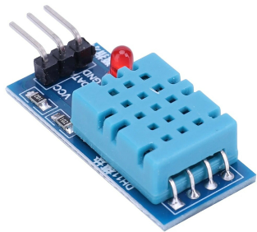
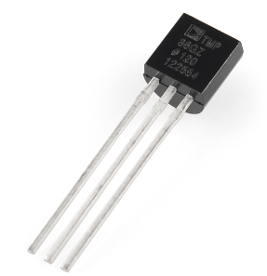
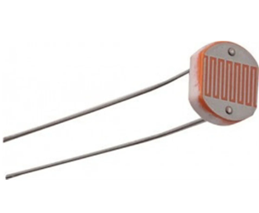
Future work
Developing an in-house environmental sensor board/ system compatible with coral mini
Optimizing the system for real-time processing: hardware acceleration or using lightweight architectures.
Customizable alert and notification systems
Images Source: Google

Slide 36
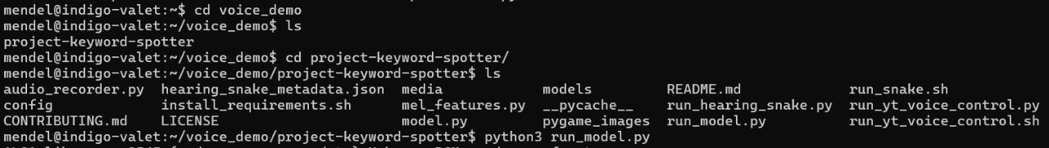
Future work
Keyphrase detection system: better alerts, fine-tune the detection,controlling, monitoring can be done using this
Results:

Slide 37
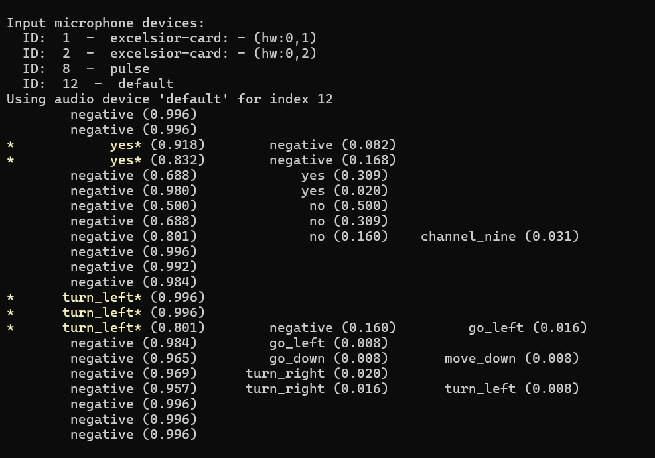
Keyphrase detection results

Slide 38
Thank You!

